Slide 1

Smart Grocery Cart Using Object Identification
Group Members:
Syed Ahmed Akmal
Muhammad Omer
Muhammad Hamza Rehman
Zain Naqvi
Supervisors:
Dr Usman Akram

Slide 2

Presentation Outline
Contribution
Problem statement
Introduction
Flow Diagram
System Level Diagram
Implementation:
Yolov4 Methodology
Model Training
Graphical User Interface
Deliverables
Relevant Work
Future work
Hardware Implementation
Demo
Conclusion

Slide 3

Group Member Contributions
Data Annotation – All members
Zain Naqvi
Model Training And Testing
Muhammad Hamza Rehman
Hardware Deployment of model And Database Workflow.
Muhammad Omer
GUI development and Bill Generation
Syed Ahmed Akmal
Database Development, Connectivity and Documentation

Slide 4

Problem Statement
The traditional systems in the grocery stores requires a lot of manpower .
Moreover, it is inconvenient for the customers as a lot of time is wasted in the billing procedures while they wait in long lines at the billing counters.
It becomes difficult to maintain social distancing for the people in traditional supermarkets during the pandemic.
Currently used Method is expensive

Slide 5
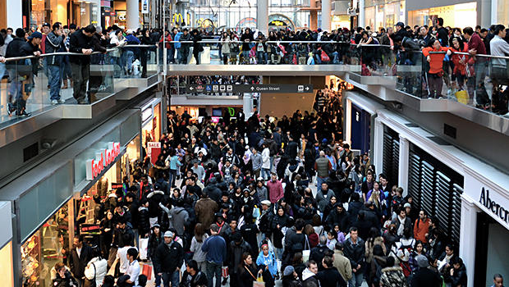
Introduction
Now world is in a digital era. In all the fields, education, medical, business, even in day-to- day life, prominence of technology is evident.
In modern times of digitization shopping at the malls and supermarkets has become a lifesaver for people with respect to time as all products are available at a single place.
However despite this they still have to wait in long queues at the end of their shopping for the purpose of billing.

Slide 6
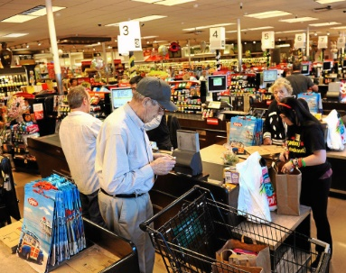
Contd.
We have decided to implement the smart shopping cart with automated billing.
Customer’s concern of waiting in long queues at the end of their shopping would be eradicated.
The malls will also benefit from it,as they no longer be needing any staff for the purpose of billing.

Slide 7
Relevant Work
Shelf Scanner , which aims to enable visually disabled people to shop in a grocery store without additional human assistance. Shelf Scanner makes it easy to identify objects on the shopping list online, in video streams in which any or all items can appear simultaneously. DOI:https://ieeexplore.ieee.org/document/5543576
When we go to shopping mart for shopping, we have to work for selecting the right product. Also, after that, it is hectic to stand in line for billing all the goods. Hence, They proposed to develop a smart shopping cart system that will keep the track of purchased products and also online transaction for billing using RFID and ZigBee. DOI:https://doi.org/10.1016/j.procs.2016.03.107

Slide 8
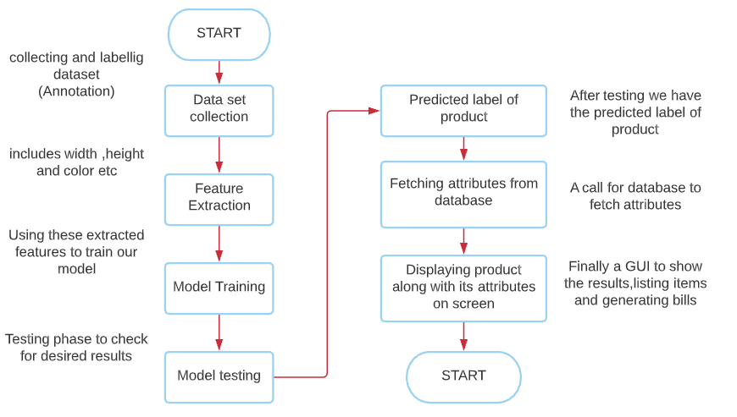
Flow Diagram

Slide 9
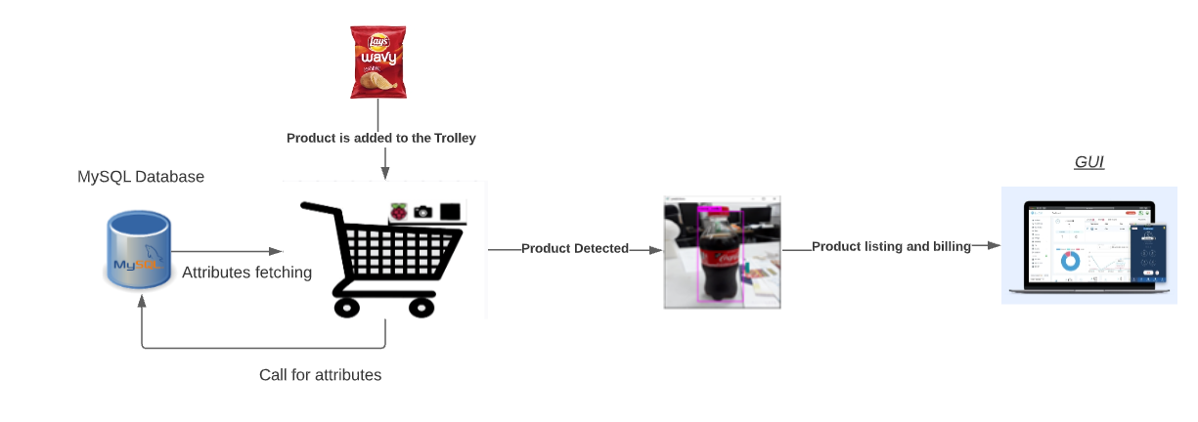
System Level Diagram

Slide 10

Implementation
We used Yolov4 Darknet model for the identification of Grocery products.
The model was trained on our custom dataset.
Annotated around 2.0k images of 17 products and after augmentation we had a total of 3852 images.
Train/Test split- 75% training, 16% validation,9 % testing set.
YOLOv4 model trained on this custom data using Darknet framework on google collaborator.
We converted the .weight file of our custom trained model into tensorflow and tflite format using Anaconda.
Deployed our custom trained model’s tflite file on Raspberry pi 4.
Developed a GUI by using Tkinter library in python to generate the bill

Slide 11
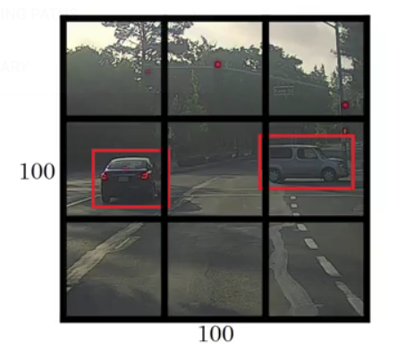
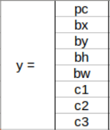
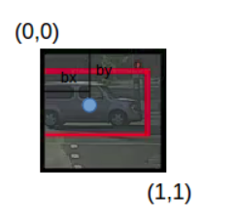
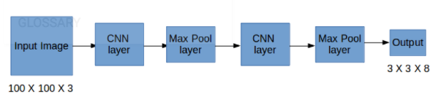
How does Yolo Framework Function
Yolo takes an Input image
The framework divides input image into grids.
Image classification and localization are applied on each grid.
Yolo then predicts the bounding boxes and their corresponding class probabilities for objects found.
For each grid cell the label y will be an eight-dimensional vector which will be used for model training.
p_{c} defines whether an object is present in the grid or not (it is the probability)b_{x}, b_{y}, b_{h}, b_{w} specify the bounding box if there is an object.
c₁, c₂, c₃ represent the classes.
b_{x}, b_{y}, b_{h}, and b_{w} are calculated relative to the grid cell we are dealing with.

Slide 12
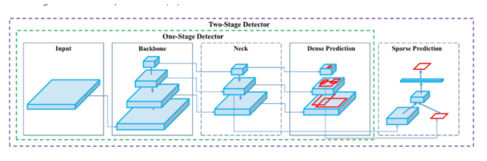
YOLOv4 methodology
An object detector basically consist of two parts that are: a backbone (pre-trained on ImageNet) and a head (for predicting the classes and the bounding boxes of the objects)
The following is breakdown of the architecture of YOLOv4:
Backbone: CSPDarknet53(neural networks)
Neck: Spatial pooling module , PANet path aggregation
Head: YOLOv3
There are 29 layers and 27.6M parameters in Yolov4 model
The purpose of adding the SPP block over the CSPDarknet53 is to increase the receptive field as well as to separate out the most significant context features.
PANet has been used as the method of parameter aggregation from different backbone levels for different detector levels.

Slide 13
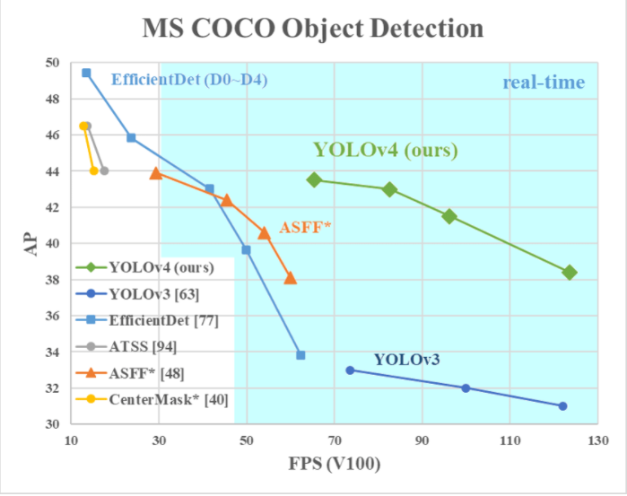
YOLOv4 methodology
YOLOv4 obtained an AP value of 43.5 percent (65.7 percent AP50) on the MS COCO dataset
Achieved a real-time speed of ∼65 FPS on the Tesla V100, beating the fastest and most accurate detectors in terms of both speed and accuracy.
YOLOv4 is twice as fast as EfficientDet
Compared with YOLOv3, the AP and FPS have increased by 10 percent and 12 percent, respectively.
The authors of YOLO v4 paper distinguish between two categories of methods that are used to improve the object detector’s accuracy
Bag of Freebies is a collection of approaches or strategies for improving model accuracy by changing the training approach or cost.
The Bag of Freebies in Object Detection is implemented in the following ways:
• Data Augmentation
• Semantic Distribution Bias in Datasets
• Objective Function of Bounding Box Regression
Bag of Specials comprises many plugins and post processing modules that only add a little amount to the inference cost but vastly improve the object detector's accuracy.

Slide 14
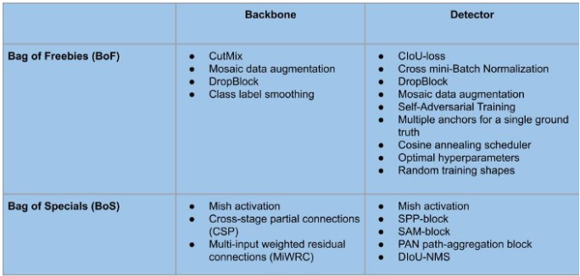
YOLOv4 methodology Cont.

Slide 15

Model Dependencies
Model was trained Google Colab using online GPU
The dependencies used
Python=3.7
Pip
Matplotblib
Cudnn
Cudatoolkit=10.1.243
Opencv
Tensorflow-gpu

Slide 16
Model Training Results And Specifications
Learning Rate | 0.001
Momentum | 0.949
Weight Decrease | 0.0005
Epochs | 2000
Ultimate loss function Value | 0.0646
mAP@(.50) | 96.80%
Precision | 86%
Recall | 83%
F1 -score | 85%

Slide 17
Result
Class Name | True Positive | False Positive
Colgate Toothpaste | 27 | 2
Italia Corn Flour | 38 | 1
Lasagne | 26 | 0
Lifebuoy | 73 | 0
Macaroni | 34 | 0
Marlboro | 24 | 0
Mitchell-s Strawberry Jam | 21 | 0
National Achar Gosht | 55 | 7
National Vinegar | 39 | 0
Nestle Mineral Water | 36 | 2
Ovaltine | 27 | 0
Power _plus | 44 | 0
Rafhan Pudding | 31 | 0
Robin Bleach | 43 | 0
Shan Korma Masala | 4 | 1
Spaghetti | 24 | 0
Tapal Green Tea | 33 | 1

Slide 18
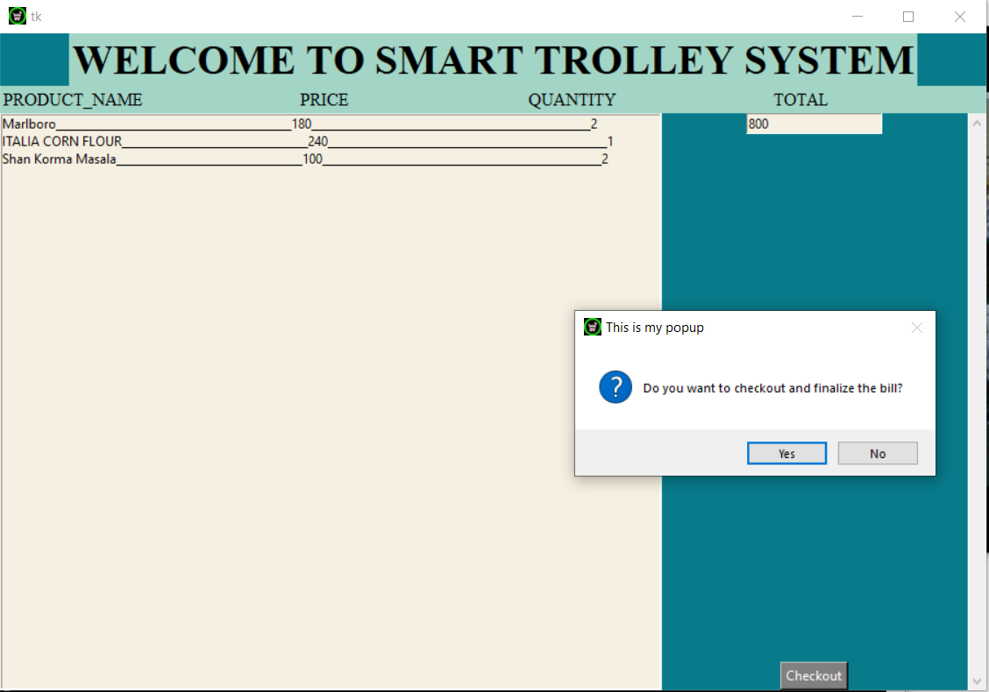
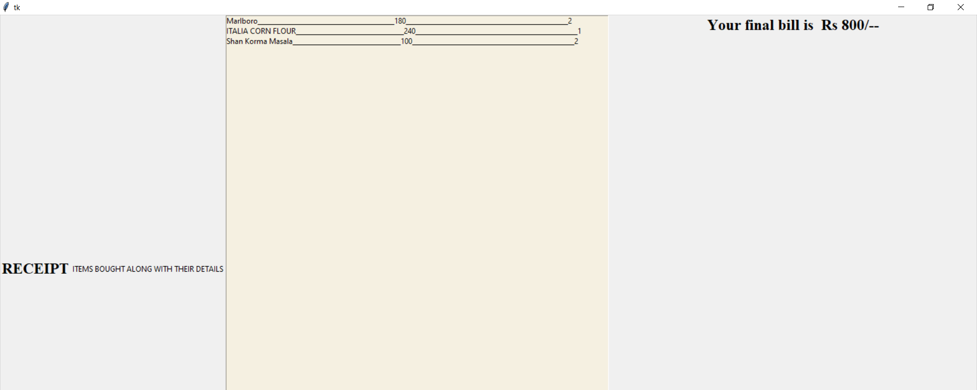
GUI and Bill Generation

Slide 19
GUI Functioning
Thread instance for GUI.
Checkout button
Inventory for scanned items
Total amount for current items
Final Bill Generation
New widget instance
Each item details, totaling
Time delay
Updation of Database
At the end of order
Inventory Flushing for the new user

Slide 20

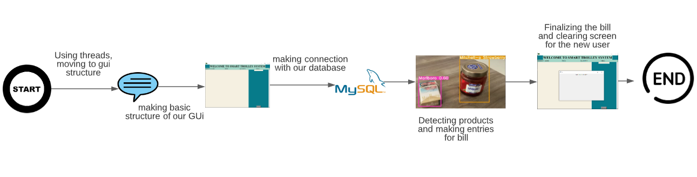
System Level Diagram FOR GUI

Slide 21
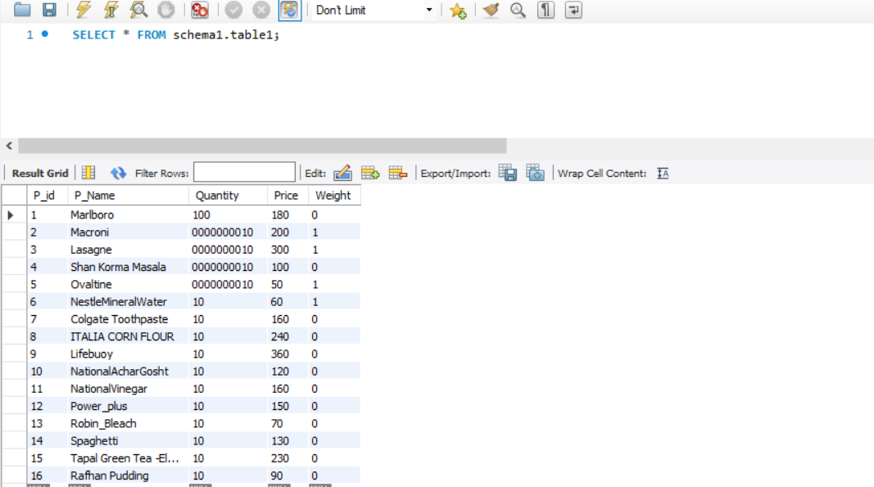
Database
We are Using MySQL Database for maintaining the Inventory of our Grocery Products.
We Have Total Of 17 classes so there are 17 rows of product.
MySQL is open source, reliable, compatible with all major hosting providers, cost-effective, and easy to manage.

Slide 22

Hardware Implementation
H/W:
RASPBERRY PI 4 MODEL B
RPI camera v2 8 Megapixel
5V-3A Power Supply
DEPENDENCIES:
Lxml
Tqdm
absl-py
Easydict
pillow
Python 3.7
Opencv=4.1.1.26
tensorflow-gpu==2.3.0rc0
LCD

Slide 23
Efficient Approach
Jetson nano:
The cheapest Jetson Nano 2GB kit is now a system-on-module with plenty of IO connectivity built into edge connectors, where the compute resource is socketed and not much bigger than a traditional laptop SO-DIMM.
This little board has a quad-core Arm Cortex A57 CPU and an integrated 128-core NVIDIA Maxwell-based GPU that accelerates CUDA-targeted workloads and has just enough storage to boot up and run a project.
Unfortunately, The Jetson Nano 2GB developer kit we Imported was faulty. We tried all the trouble-shooting we can but it didn’t work.

Slide 24
Conclusion
The smart cart system suggested in this study outperforms existing unmanned store options in terms of cost-performance ratio.
Even if the capacity increases, the proposed system is unaffected. It also consumes a little amount of CPU power.
Furthermore, unlike the traditional way, RFID does not have to be attached to all items. Speed and accuracy are trade-offs in the world of product detection, however because this system required real-time processing, it was done using YOLO.
It is expected that in the future, this section can be substantially enhanced by updating the object detection model.

Slide 25
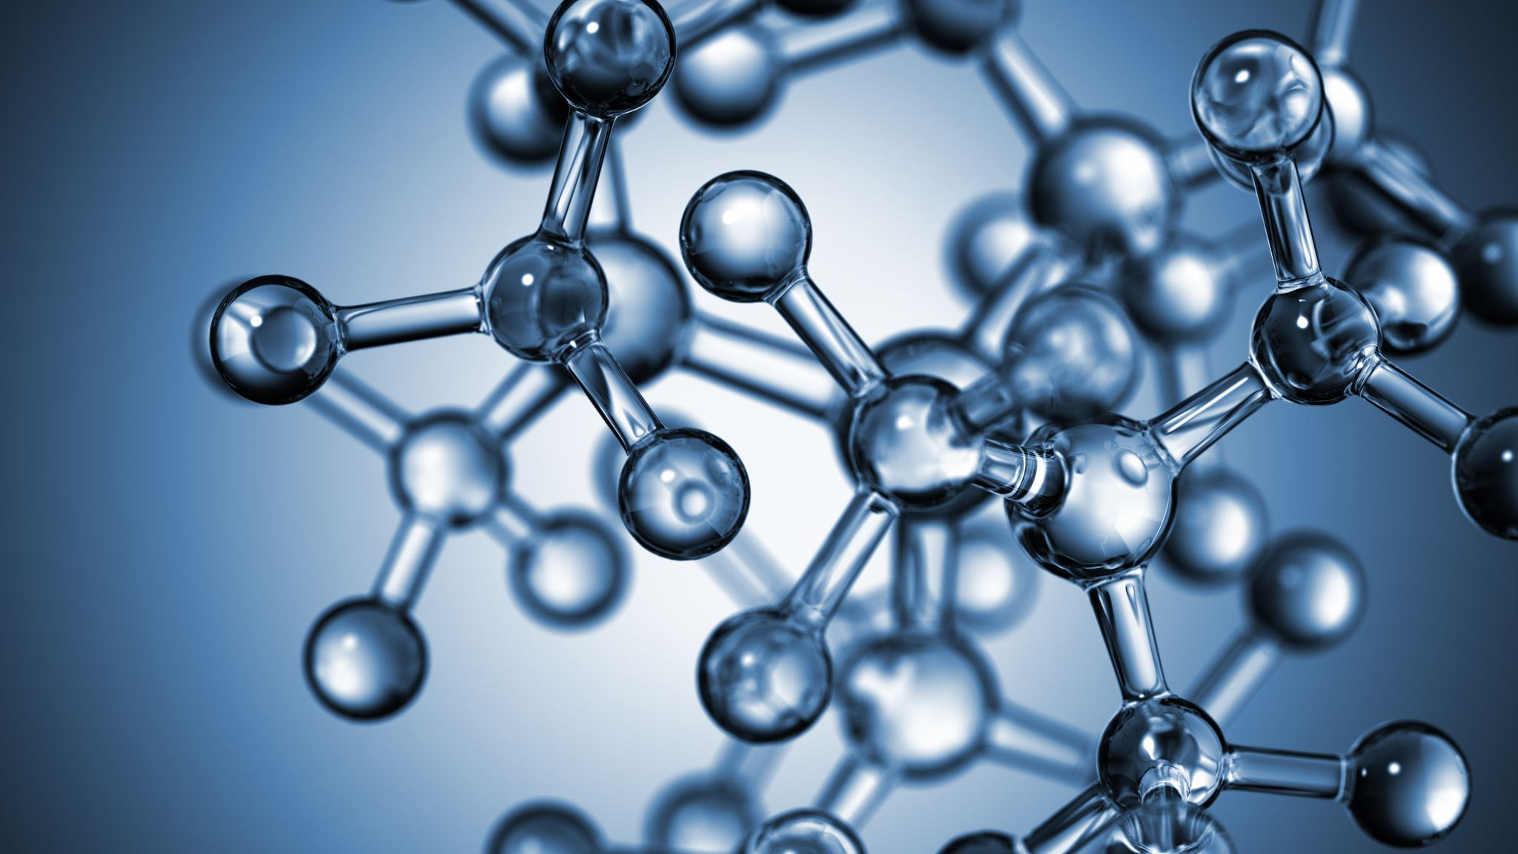
Deliverables
The primary deliverable for this project is a working model that is sufficiently accurate to predict the Grocery item being put in the cart.
Each product kept in the trolley will be added to the virtual cart which is a unique to each customer.
A bill will be generated after the customer checks out.
Customer can pay for the products through credit/debit card by swiping the card at the preinstalled credit card receiving device in the trolley.
Saving time and providing better shopping experience.

Slide 26

Future Work
Adding Weight Sensor To overcome fraud.
01
Adding Payment Gateway.
02
Deploying This On Jetson Nano as it has better Computational and processing power.
03
Transfer learning
04

Slide 27
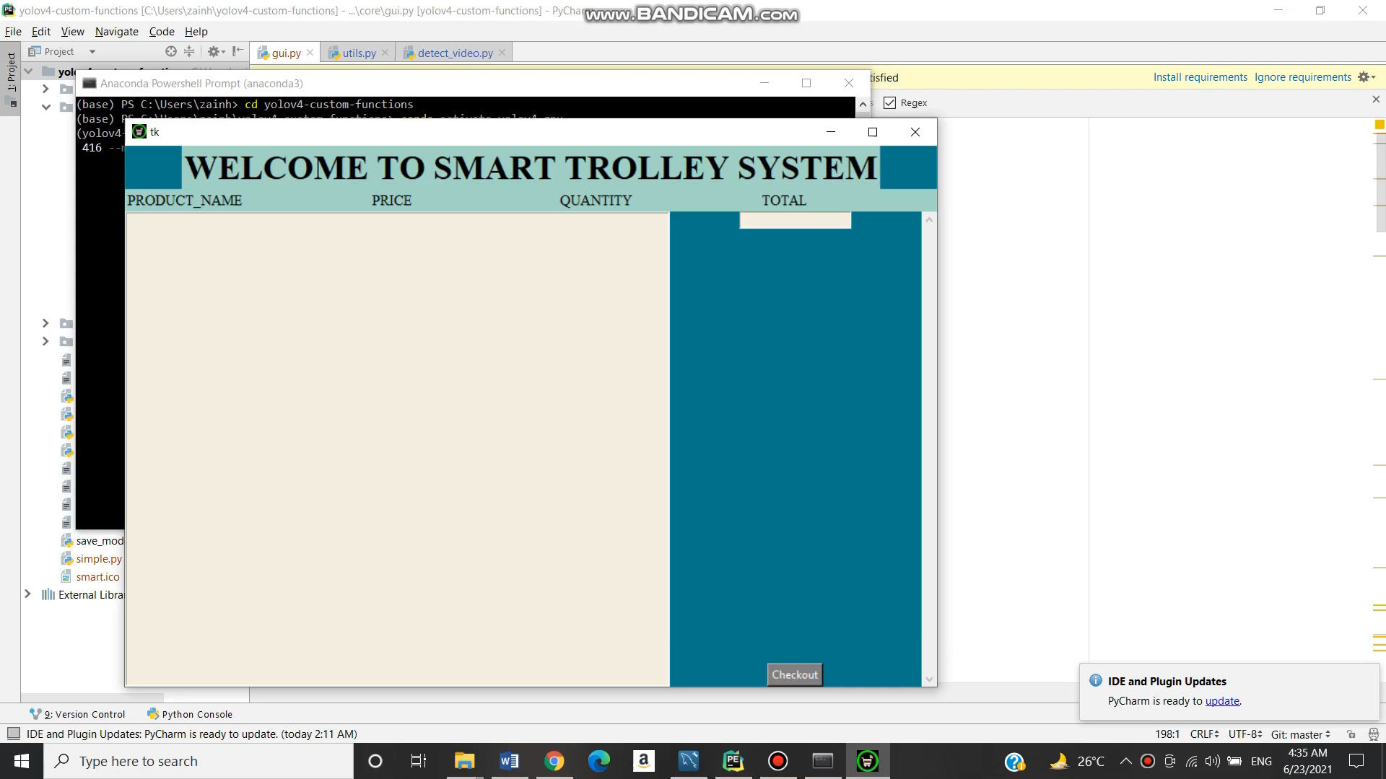
SHORT DEMO

Slide 28
References:
T. Winlock, E. Christiansen and S. Belongie, "Toward real-time grocery detection for the visually impaired," 2010 IEEE Computer Society Conference on Computer Vision and Pattern Recognition - Workshops, 2010, pp. 49-56, doi: 10.1109/CVPRW.2010.5543576.
Herbert Bay, Andreas Ess, Tinne Tuytelaars, and Luc Van Gool. 2008. Speeded-Up Robust Features (SURF). <i>Comput. Vis. Image Underst.</i> 110, 3 (June, 2008), 346–359. DOI:https://doi.org/10.1016/j.cviu.2007.09.014
Recognizing Products: A Per-exemplar Multi-label Image Classification Approach, D. Fleet et al. (Eds.): ECCV 2014, Part II, LNCS 8690, pp. 440–455, 2014. doi:http://www.vs.inf.ethz.ch/publ/papers/mageorge_products_eccv2014.pdf
P. Mukherjee, S. Srivastava and B. Lall, "Salient keypoint selection for object representation," 2016 Twenty Second National Conference on Communication (NCC), 2016, pp. 1-6, doi: 10.1109/NCC.2016.7561176.
Annalisa Franco, Davide Maltoni, and Serena Papi. 2017. Grocery product detection and recognition. <i>Expert Syst. Appl.</i> 81, C (September 2017), 163–176. DOI:https://doi.org/10.1016/j.eswa.2017.02.050
Jianguo Zhang, M. Marszalek, S. Lazebnik and C. Schmid, "Local Features and Kernels for Classification of Texture and Object Categories: A Comprehensive Study," 2006 Conference on Computer Vision and Pattern Recognition Workshop (CVPRW'06), 2006, pp. 13-13, doi: 10.1109/CVPRW.2006.121.
3D Object Recognition for Automated billing in a Supermarket using Hybrid PCA-SIFTFREAK Algorithm,Manisha Agrawal,Nathi Ram Chauhan
DOI:10.15662/IJAREEIE.2017.0607075

